Slide 1
CSM 61A Midterm 1 Review

Slide 2
WWPD

Slide 3
Boolean values in Python
slide creds to Chris A.’s discussion
False-y
False
0
None
“ ”, [ ], { }
Truth-y
True
1
-1
“Hello”
Almost everything else

Slide 4
Logic
slide creds to Chris A.’s discussion
And
Evaluates to first false-y or last truth-y value (and stops evaluating there)
“Are you free Saturday and Sunday?”
Or
Evaluates to first truth-y or last false-y value (and stops evaluating there)
“Are you free Saturday or Sunday?

Slide 5
Booleans - Short Circuiting
slide creds to Neil K.’s discussion
In a nutshell, do as little work as possible
Short Circuiting with AND:
>>>False and <anything> False
>>>True and True True
>>>True and False False
Short Circuiting with OR:
>>>True or <anything> True
>>>False or True True
>>>False or False False

Slide 6
Booleans - Short Circuiting
slide creds to Neil K.’s discussion
You can replace `True` or `False` with any Truth-y or False-y value and Python will evaluate the same way, but it will return the “real” value.
Short Circuiting with AND:
>>>None and <anything> None
>>>True and 1 and “hello” a “hello”
>>>True and 0 and 1 and True 0
Short Circuiting with OR:
>>>1 or <anything> 1
>>>False or 1004 1004
>>>0 or None or “” “”

Slide 7
Assignment Statements
Evaluate right side of equals first, then bind to left
>>> one = 1
>>> two = 2
>>> one, two = two, one
>>> one 2
>>> two 1

Slide 8
Control Statements
slide creds to Neil K.’s discussion
Identifier | How Many? | Optional?
if | 1 | no
elif | 0 - infinity | yes
else | 0 or 1 | yes

Slide 9
WWPD Tricks
print(x)
Prints x
Evaluates to None
return x
Stops execution
Causes the function call to evaluate to x
What’s the difference :
def f1():
if ___:
return ____
return
def f2():
if ____:
print ___
return ___
Notes:
Potentially change the line “prints x” under the “return x” bullet point. It might be misleading to students.

Slide 10
WWPD Problem 1
def printer():
x = 3
count = 0
while count < 3:
x = print(x)
count += 1
>>> printer()

Slide 11
WWPD Problem 1 (Sol.n)
>>> printer()
3
None
None

Slide 12
WWPD Problem 2
slide creds to Sp18 MT1 Review Session
def quick_maths(man, free):
print(man)
if man % 2 == 0 and free:
return quick_maths(man + 2, not free)
else:
man -= 1
if man == 3:
print(man)
else:
return man
>>> big_shaq = 2
>>> print(quick_maths(big_shaq, True))
2
4
quick_maths(4, False)
3
None
No more code to run!

Slide 13
WWPD Problem 3
>>>print(1, print(2))
>>>argentina(0)
>>>argentina(1)(square)
def square(x):
return x * x
def argentina(n):
print(n)
if n > 0:
return lambda k: k(n+1)
else:
return 1 / n
2
1 None
0
Error
1
4

Slide 14
Environment Diagrams

Slide 15
Environment Diagram Rules
Frames
Always start with the global frame
Any other frame that is opened will be for
Calling user-defined functions (not built-in)
When looking up a variable:
1. Look for the variable in your current frame. If it is not there, then
2. Look in the parent frame.
Notes:
Make clear what is the difference between “global” and “local” frames. These terms can be confusing but are very important as you do more complicated env diagrams!
Ensure students are clear about what a frame is. Local frames should have access to variables defined within that function, as well as any variables in the parent frame, and its parent frame… etc
Parent frame is where the function was defined. E.g. if we define a function in the leftmost indent of code, we put in in the global frame [Parent = Global]. If a function is defined in the f2 frame, but an f3 frame is already defined, the function is put in the f4 frame, but the parent is f2! Make sure this is clear because a common misconception is that the parent frame is just one frame above the current frame (often true, but as we know, not always true).

Slide 16
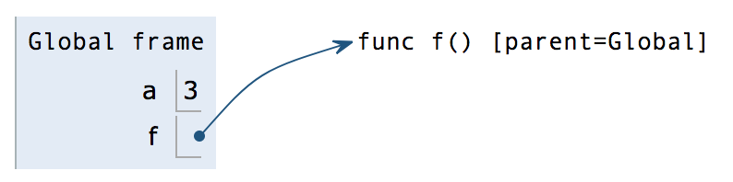
Environment Diagram Rules
Assignment Statements
Primitive types (numbers, booleans, strings) go directly in boxes!
Everything else (functions, lists, etc.) needs a pointer!
Notes:
Primitive expressions evaluate to their value in one step (e.g. numeric values, strings, booleans)
Call expressions follow the “Golden Rules” of evaluation (e.g. foo(1, 2), 3 + 4, bar(‘hello’)) - explained in following slides
Note that the pointer itself is what goes in the box!
Always remember to write the function’s parent so we don’t forget later!

Slide 17
Environment Diagram Rules
def Statements
Don’t look inside functions when they are being declared.
Only look inside then when they are called
Parent of new function is the frame in which it was defined
Example:
https://goo.gl/hFM5f2
Notes:
Note: “inside function” means the next level of indentation
Reiterate the importance of making sure parent is correctly defined! Easy to assume that we just look one frame up.
Very important: new frame = new function CALL not DEFINITION

Slide 18
Call Expressions
Golden Rules of Evaluation
Evaluate the operator (the function being applied)
Evaluate the operand(s) (the arguments)
Apply operator to operands
Sanity Check
foo(bar(1), 2)
What order is each operator and operand evaluated and applied?
What function is the first frame opened for?
Notes:
“Evaluate” = see what that variable points to! In the sanity check, foo points to the function foo, so when we evaluate it, we know that we have a function that takes in 2 arguments!
Primitive types evaluate to themselves.
In the sanity check, ensure students realize that we actually evaluate bar(1) before we call foo! May be confusing since we are evaluating foo in the first step, but not calling it!

Slide 19
Call Expressions
Whenever we open up a new frame:
Label frame with intrinsic function name and parent frame
Set formal parameters (in the def line) to arguments passed in (in the call line)
Quick Example
https://goo.gl/7xTpEy
Notes:
“Intrinsic” may be kind of confusing, so be clear on this! A good example is you have a variable foo that points to a function bar(), the intrinsic name would be bar, not foo! This is why it is really important to always follow your pointers to see what function you are really calling.
Especially on midterms when the names are intentionally confusing, messing this up once could be costly.
Lambda functions are always named lambda (even if they’re assigned to a variable)

Slide 20
A Warm-Up
a = 1
def b(b):
return a + b
a = b(a)
a = b(a)
Follow along here! https://goo.gl/5pYMp8
Bonus question: What happens to a each time we call a = b(a)?
Notes:
Note that this is a simpler example. Try to go through this fast-ish

Slide 21
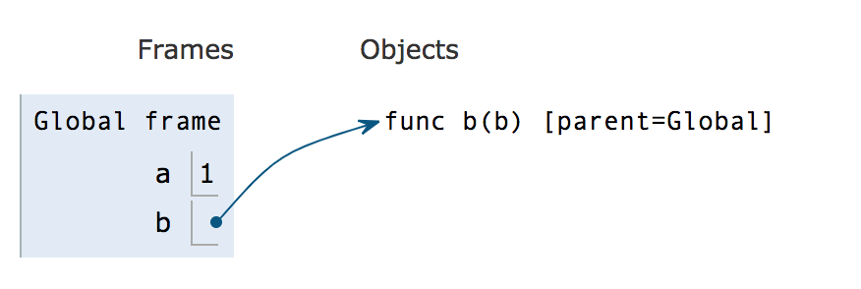
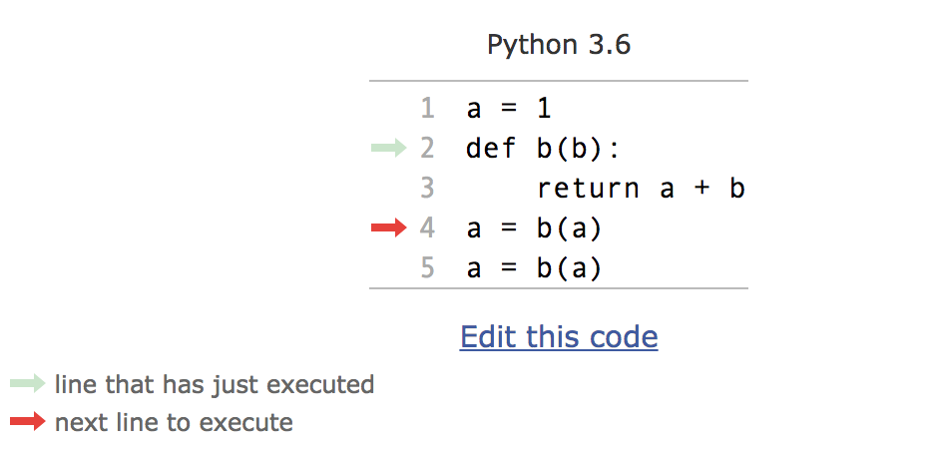
Explanation
Start by binding variable a and function b to their respective values in the Global frame.

Slide 22
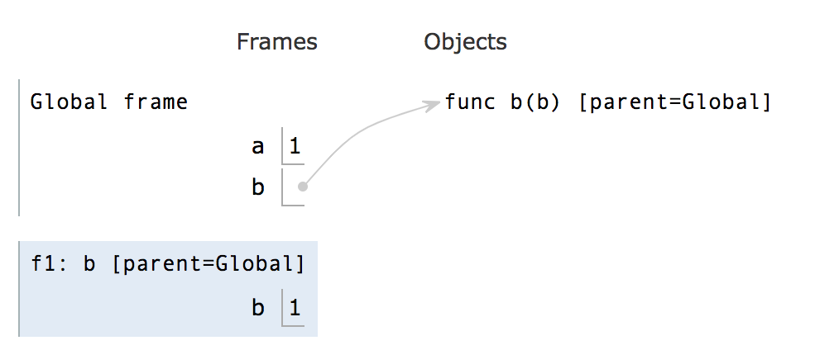
Explanation
Start the call to function b, which includes writing out the intrinsic function name and binding its parameters.
Notes:
We are on line 2 now. Maybe note that the parameter called b in the local scope is what a was in the global scope

Slide 23
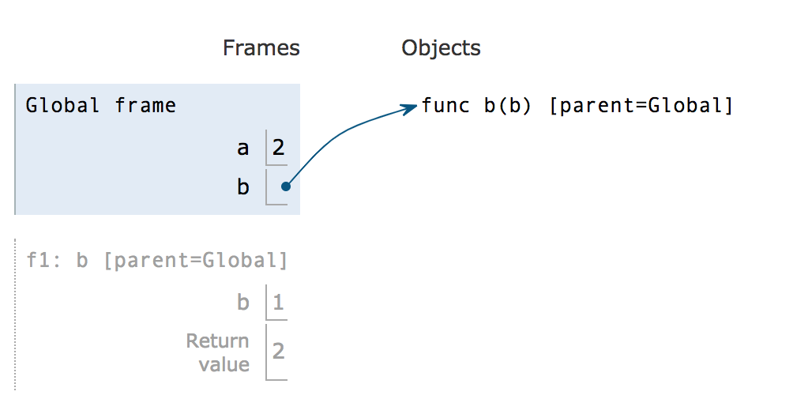
Explanation
We return a + b and finish reassigning a
Lookup a first -- it doesn’t exist in the local frame, so we look to the parent frame (Global) and find a = 1.
Lookup b. It exists in the local frame, so we have b = 1.
Returning a + b = 1 + 1 = 2
Reupdate a in our global frame to the return value, 2
Notes:
Two parts to this slide
We execute the return statement. This is important to go over for the lookup process of the variables
We go back to line 4 and finish reassigning a to b(a) which returned 2

Slide 24
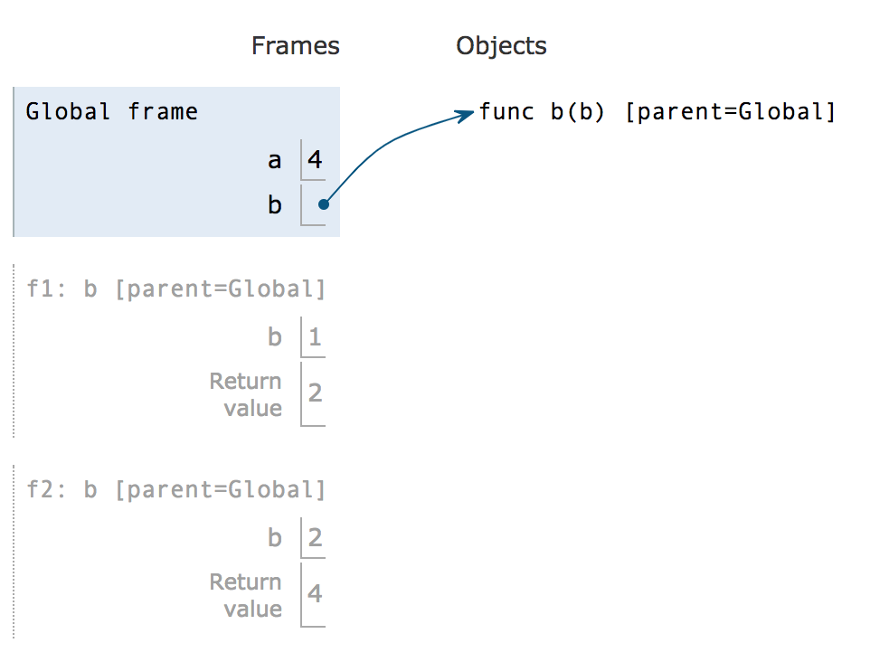
Explanation
We go onto line 5, a = b(a) again. Similarly to the last call, we open up the new frame and execute the return statement with our new b and a values and reassign a.
We’re done with our environment diagram!
Answer to the bonus question:
Each time we call a = b(a), a doubles!
Notes:
This slide is going through a lot of steps, but they’re all the same as the last two slides
The bonus question was each time we call a = b(a), what happens? It should double each time given a starts at 1. No need to really go over this, just a fun tidbit

Slide 25
Your turn to try one!
def snow(snow, x): if snow(x, x) == x: def x(x): return 32 return x(x) else: return snow(snow, x) def flake(x, y): return y + x - 1 griffin = snow(flake, 1)
Follow along here! https://goo.gl/hVBtRG
Notes:
Key here is going relatively slow because it is a more complicated example.
Potentially confusing aspects that you should double check the students are okay with:
There are many variables ‘x’. We have arguments passed into several functions with the name, as well as a function named x. Organization is key here! Additionally, assure the students that if they take this step by step, they can overcome that initial confusion!
We are passing in a function as an argument, so the formal parameters for the function snow will be a pointer to a function flake. Important because even though the parameter is named snow, the intrinsic name of the function it points to is flake.
The inner x(x) function that returns 32 is only defined if we hit the first if statement. Good lesson that sometimes we don’t have to define every function written in the code, if our execution does not hit that conditional.

Slide 26
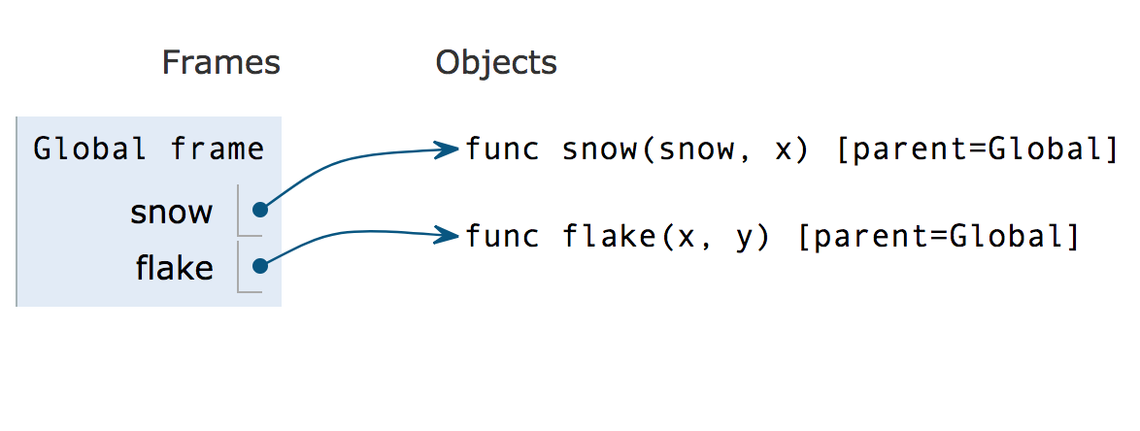
Explanation
Start by defining the global frame and binding snow and flake to their respective function objects
Remember, we don’t go into the body of functions when we are defining them!

Slide 27
Explanation Cont.
After jumping to the last line in the program, we see that there's an assignment statement.
Remember, Python always evaluates the RIGHT side of the assignment statement first, then binds the value to what’s on the LEFT.
The RHS is a call expression so we evaluate the operator (snow function) and operands (flake function, 1).
Notes:
Second sentence is super important! Probably say this twice just so it really goes into students heads. Common misconception is that since we read left to right, we would follow a similar logic here. But we want to totally evaluate the RHS and then assign the LHS to that evaluated RHS.

Slide 28
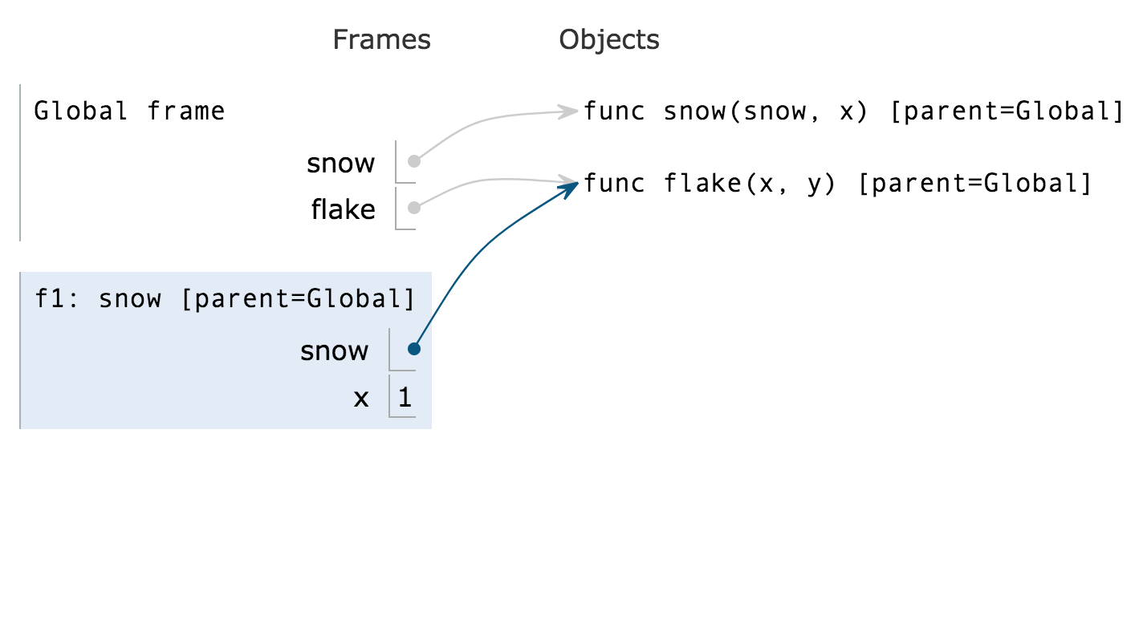
Explanation Cont.
Now, we're ready to apply the operator to the operands and create a new frame f1!
We can set the parameters of the snow function (snow, x) to the arguments passed in (flake, 1).
Notes:
Make note of how the snow variable in frame 1 POINTS to the flake function; we don’t rewrite flake, just point to it!

Slide 29
Explanation Cont.
Now, we can go through the body of the function.
There is a call expression, so we can evaluate the operator and operands of the expression.
What is the value of snow? To lookup this value, first we look in the current frame. Does there exist a value of snow in the current frame?

Slide 30
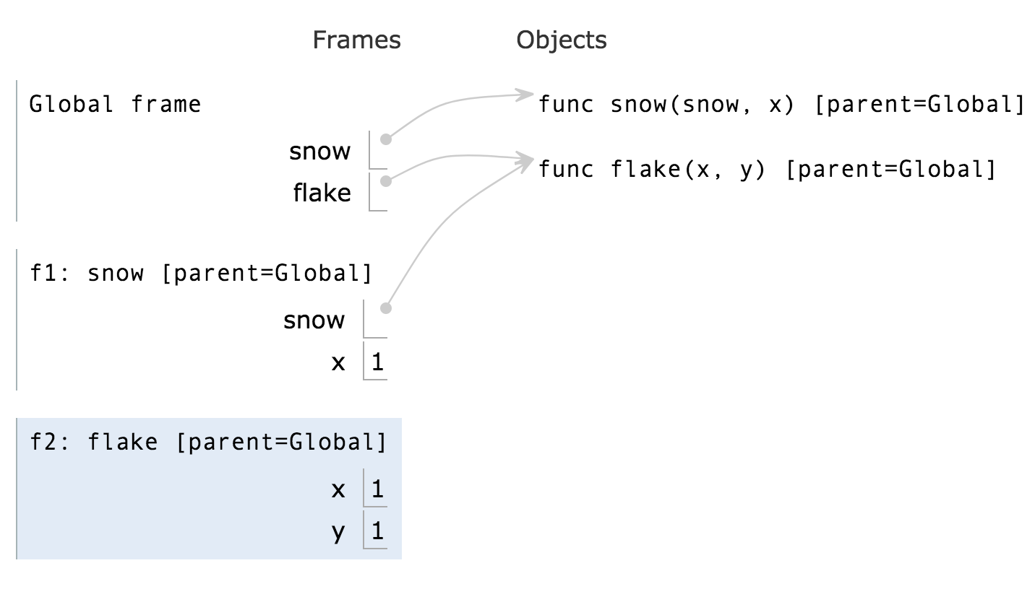
Explanation Cont.
Now we can create a new frame f2 for flake.
Notice it’s called flake, not snow, since flake is the intrinsic name.

Slide 31
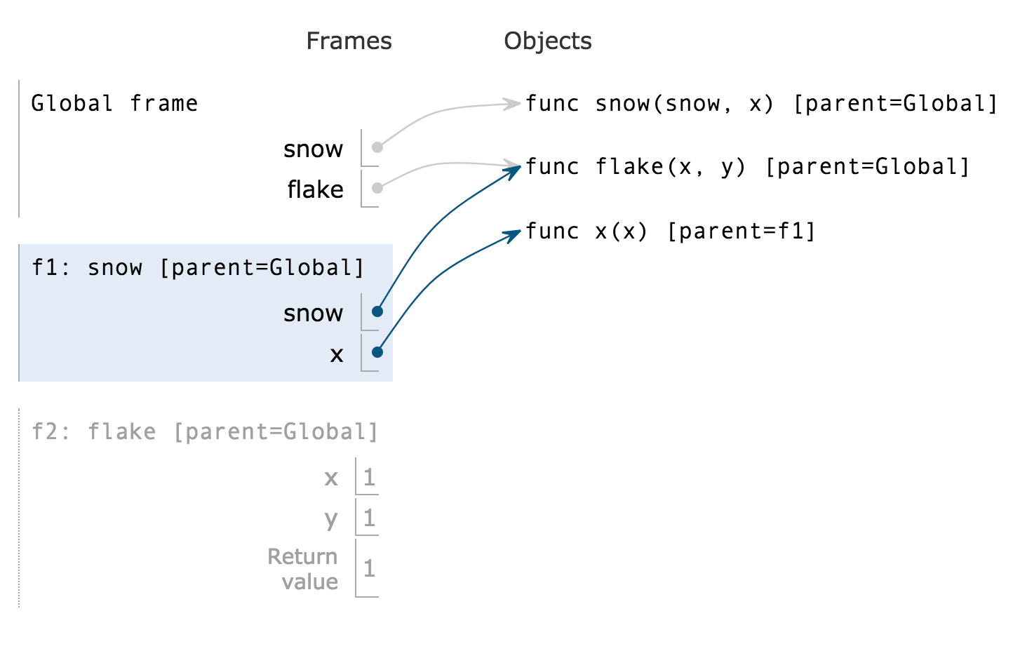
Explanation Cont.
Since this if statement's condition is true, we can go to the body of the statement.
We define a new function x, then jump to the ‘return x(x)’ line.

Slide 32
Explanation Cont.
At this point in the environment diagram, x is set to a function in the current frame.
So when we evaluate x(x), both x’s are this function! It’s a HOF!

Slide 33
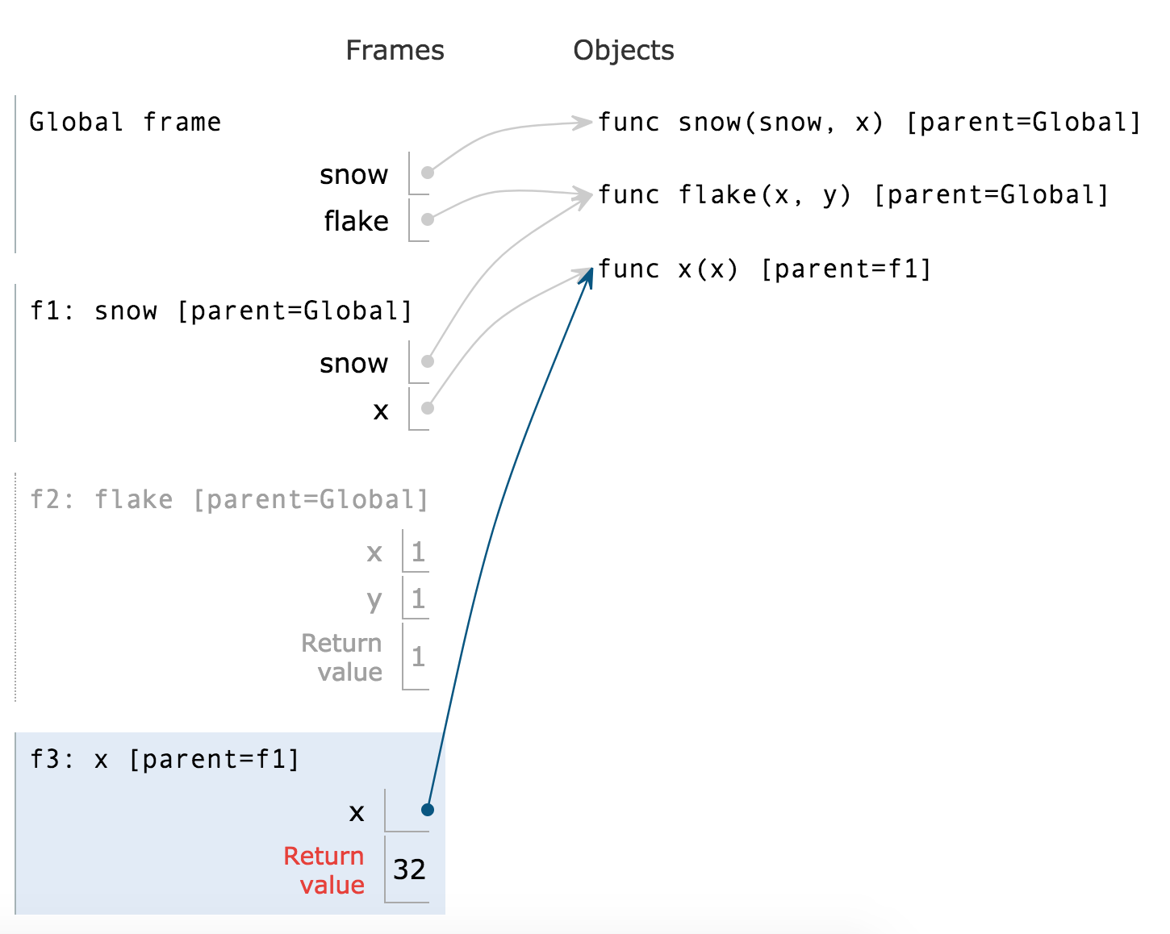
Explanation Cont.
We open up a new frame to evaluate the x(x). This is a HOF, since the parameter we passed in is a function. It also happens to be the same function as one we are calling! We evaluate and return 32.

Slide 34
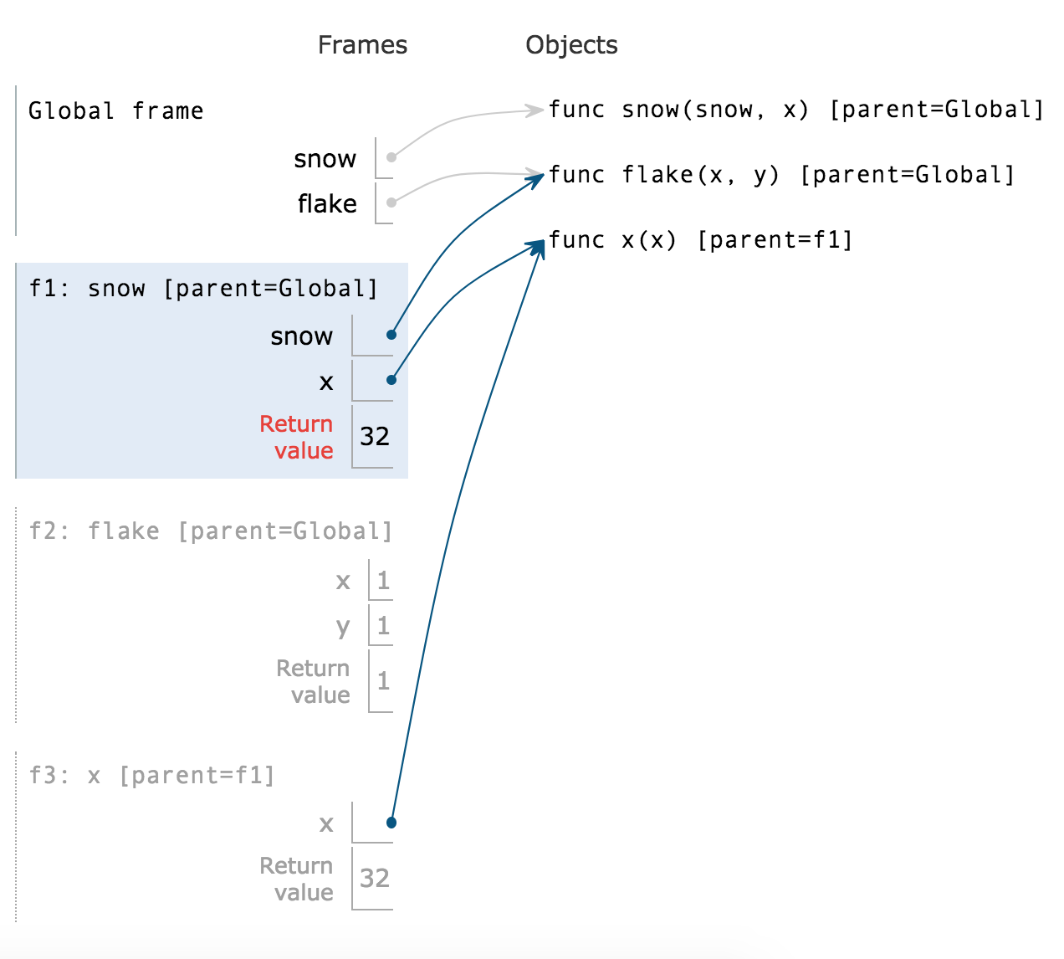
Explanation Cont.
Because we originally opened up f3 in order to return its result back up in f1, we now return x(x) = 32 in f1 (snow).

Slide 35
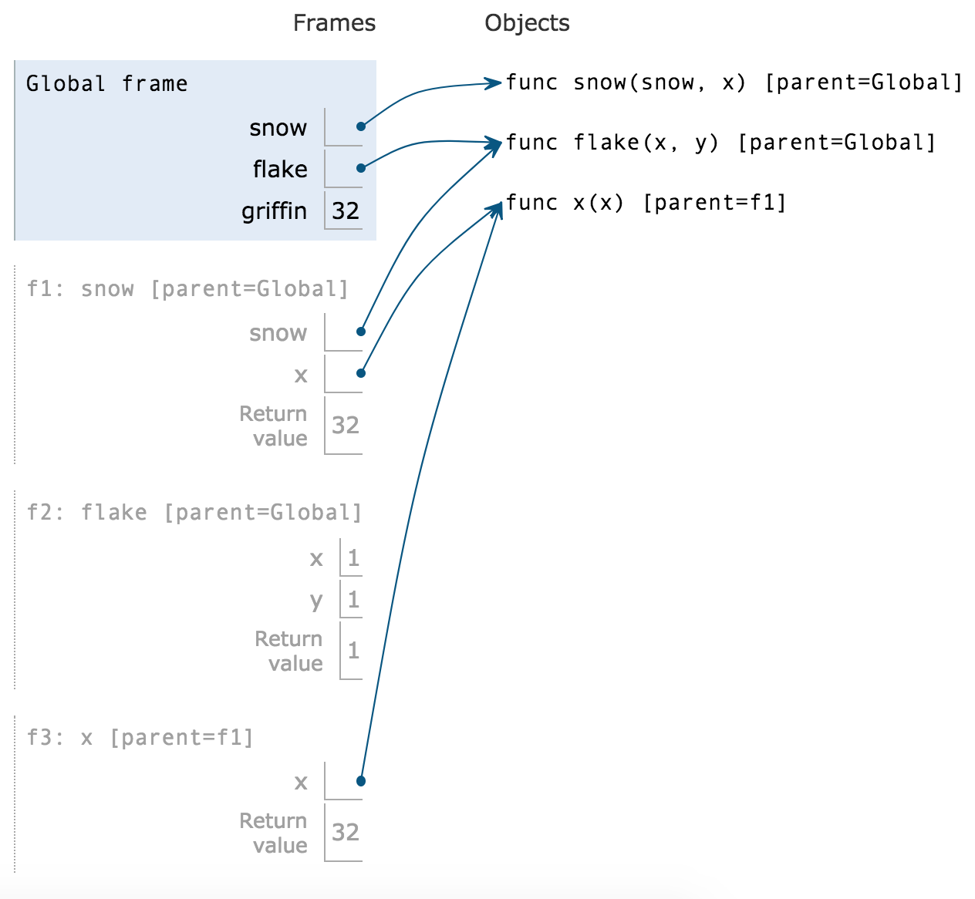
Explanation Cont.
Return all the way back to the global frame. Our original goal was to set griffin to the value returned by snow, which is 32. We’re done!

Slide 36
HOFs

Slide 37
Higher Order Functions (HOFs)
A function that takes in a function as an argument, or returns a function
Various applications due to this “first-class” nature:
Nested function definitions
Lambdas

Slide 38
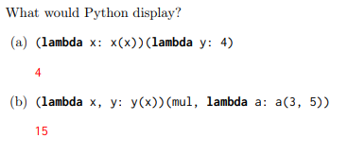
HOF Problem #1

Slide 39
HOF Problem #1
4
15

Slide 40
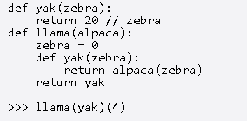
HOF Problem #2
Draw the environment diagram of the following code:

Slide 41
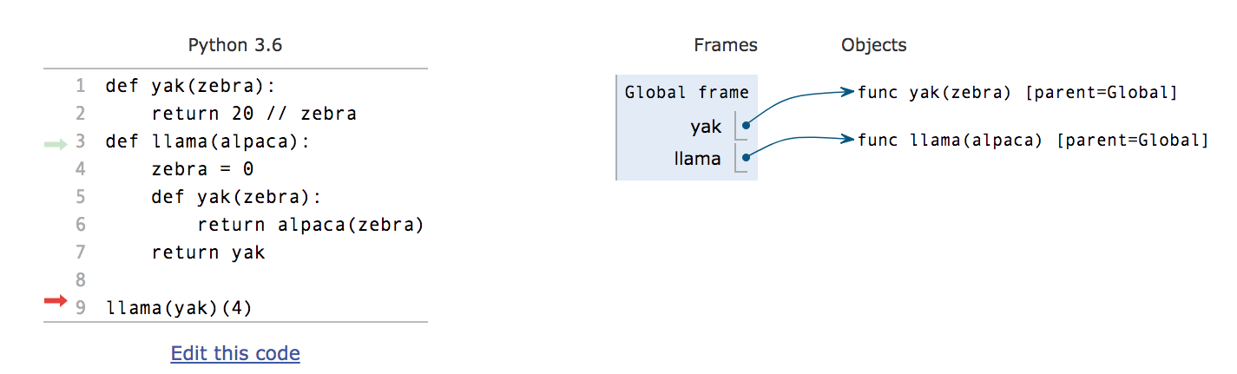

Slide 42
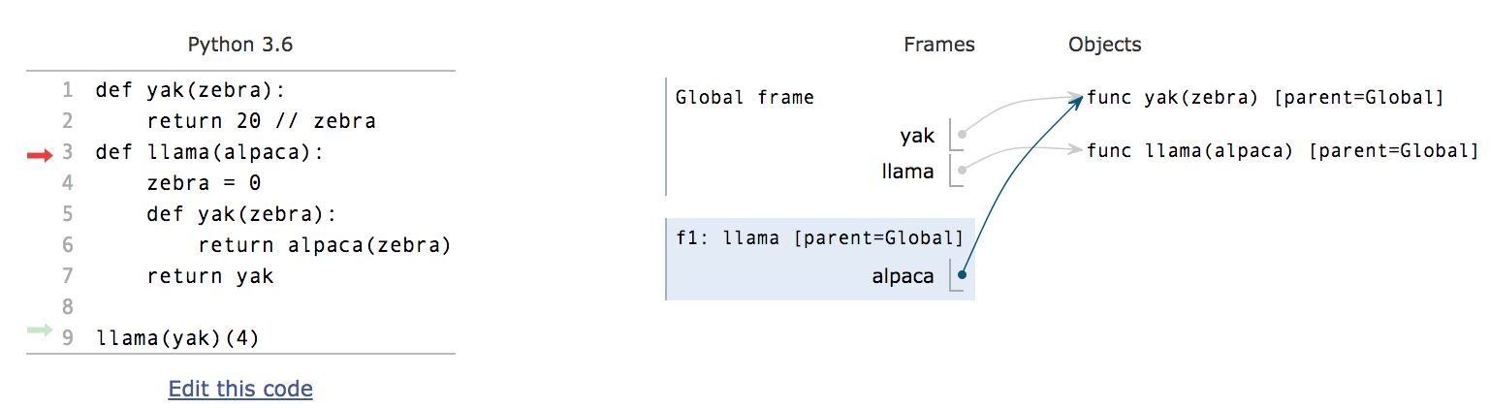

Slide 43
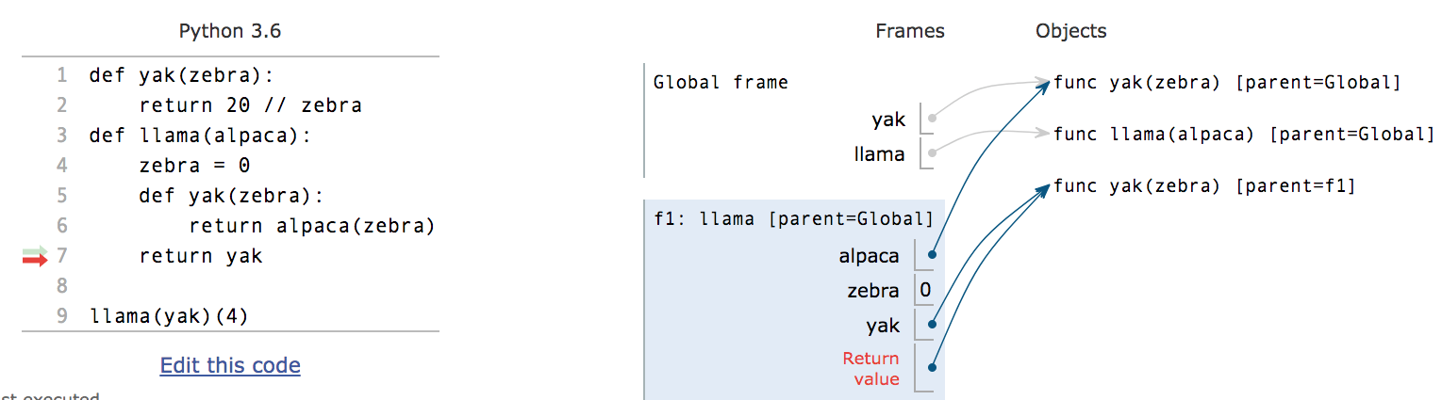

Slide 44
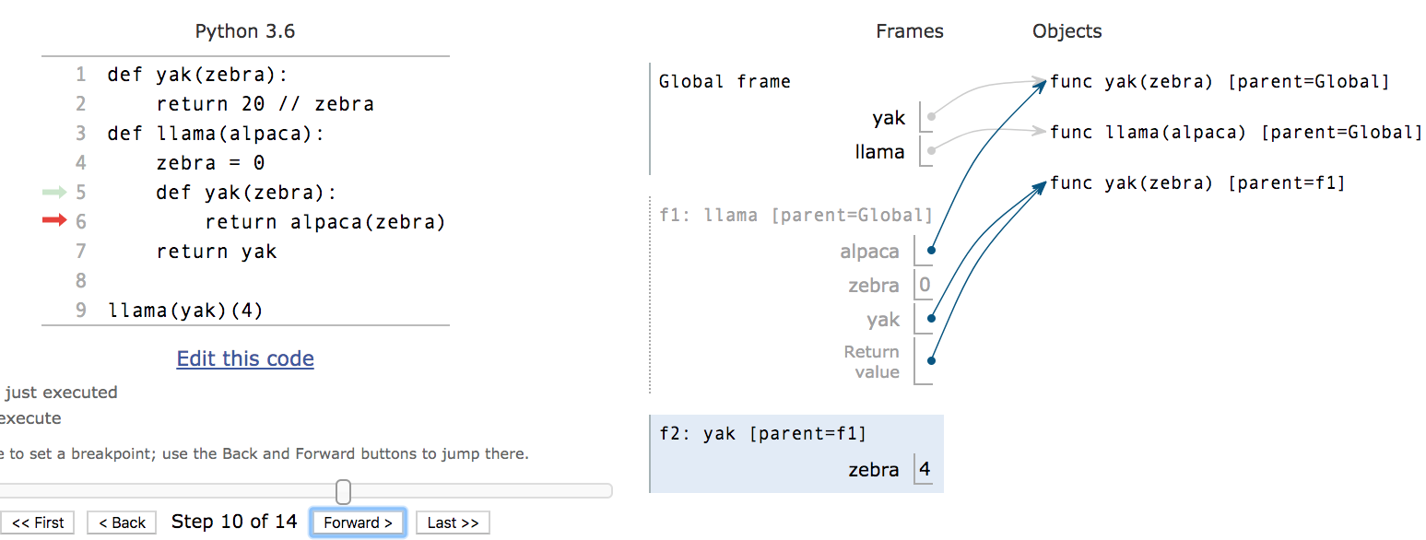

Slide 45
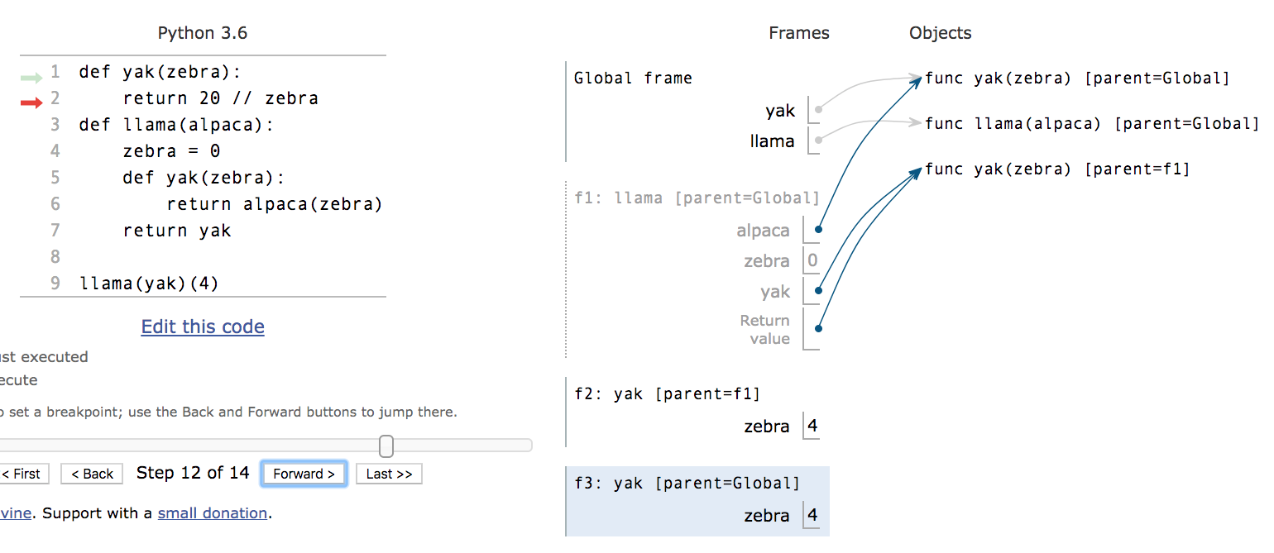

Slide 46
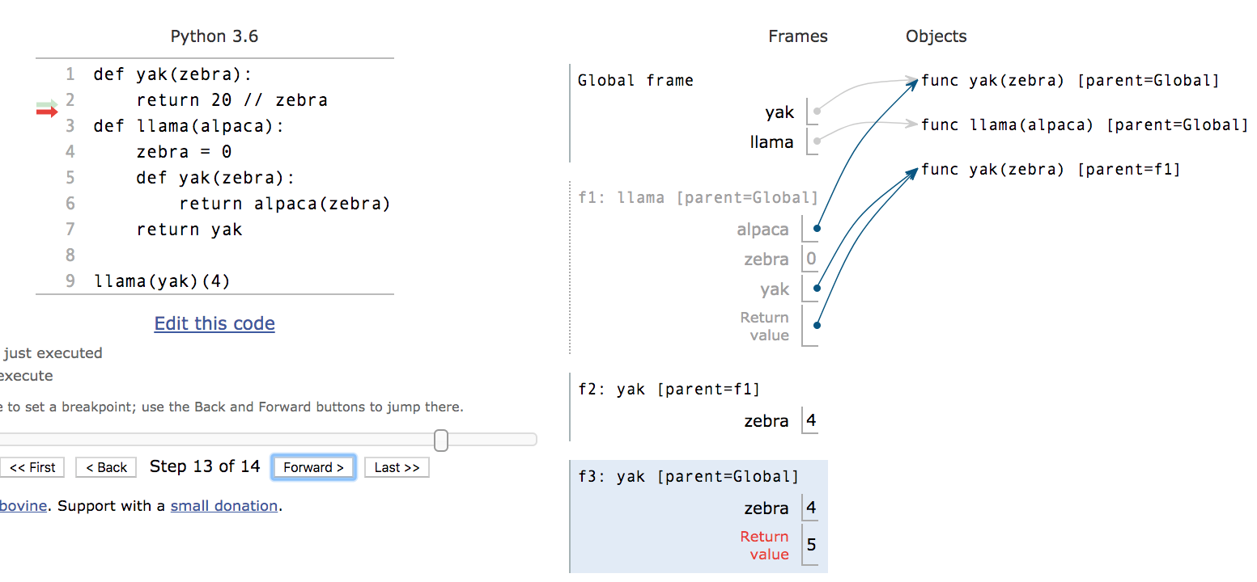

Slide 47
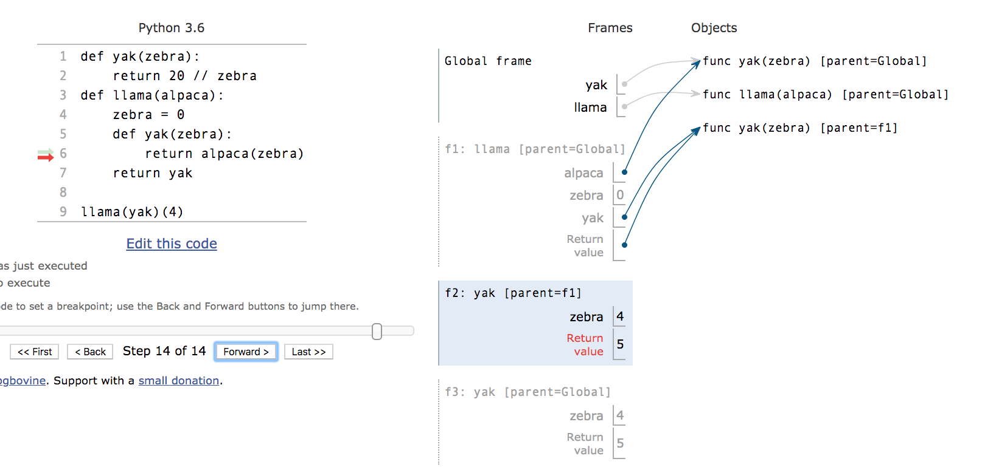

Slide 48
HOF Problem #3
def whole_sum(n):
"""
Return a function which checks whether the digits
in x add up to n.
>>> whole_sum(21)(777)
True
>>> whole_sum(142)(10010101010)
False
"""
def check(x):
_____________
while ______:
last = ______________
_____________________
_____________________
return ____________
return _____________
total = 0
x > 0
x % 10
x = x // 10
total = total + last
n == total
check

Slide 49
Higher Order Function Code Writing
def curry_forever (f, arg_num):
"""Takes in a function f which has two arguments and returns a function that allows us to enter arg_num amount of numbers into f one by one. Assume the starting point for f is 0 (e.g.passing mul in as f would return 0).
>>> g = curry_forever(add, 4)
>>> g(1)(2)(3)(4) # 1 + 2 + 3 + 4
10
"""

Slide 50
Higher Order Function Code Writing
def curry_forever (f, arg_num):
def helper _____________:
if arg_num == 0:
_________________________________________________
return __________________________________________
____________________________________________________

Slide 51
Higher Order Function Code Writing
def curry_forever (f, arg_num):
def helper_________________
if arg_num == 0:
_______________________________________________
return __________________________________________
_____________________________________________________
(arg_num, amt)
return amt
lambda x: helper(arg_num - 1, f(amt, x))
return helper(arg_num, 0)
Notes:
Note: This question does have recursion in it, so don’t worry about it as much, but it’s good practice

Slide 52
Challenge HOF Questions

Slide 53
Order-n Function: returns an order-n-1 function if n > 1, and another value otherwise.
Therefore, if f is an order-3 numeric function, we could do something like f(1)(2)(3)
apply_n takes an integer n, a one argument function base_fn, and a value x. It returns an order-n function which takes in one argument, a function. If this order-n function is called on a sequence of functions, it should return the result of applying each of them to base_fn(x)
If n = 0, it should just return base_fn(x).

Slide 54
def apply_n(n, base_fn, x):
def take_fn(f):
return apply_n(__________________)
if n == 0:
return ___________________
else:
return ___________________
"""
>>> incr = lambda x: x + 1
>>> double = lambda x: x * 2
>>> identity = lambda x: x
>>> print_plus_one = lambda x: print(x + 1)
>>> apply_n(2, identity, 1)(double)(incr)
3
#incr(double(identity(1)))
>>> apply_n(0, identity, 2)
2
#identity(2)
>>> make_print = apply_n(1, print_plus_one, 1)
>>> make_print(lambda x: print(x))
2
None
"""

Slide 55
def apply_n(n, base_fn, x):
def take_fn(f):
return apply_n(______________________________)
if n == 0:
return ________________________
else:
return ___________________ _____
n - 1,
lambda x: f(base_fn(x)),
x
base_fn(x)
take_fn

Slide 56
Advanced HOF Problem
Note: This includes material that we have not seen in the course yet!
def kill_the_n(n):
#removes smallest occurence of the appearance of x in n.
#ex: kill_the_n(99)(10990990) ==> 109900
#ex: kill_the_n(99)(900999) ==> 9009
#ex: kill_the_n(99)(989) ==> 989
def kill(x):
_________________________________________________
for i in range(___________ - ___________, 0, -1):
if ___________[___________:___________+num_digits(n)] == ___________:
return int(___________[:i] + ___________[i+num_digits(n):])
return int(___________)
return ___________
def num_digits(n):
#Finds the number of digits in the positive number n
if n == 0:
return 0
return 1 + num_digits(n//10)
Notes:
Giving them hints:
What should the outermost return statement be returning? A function or a function call?
Why are there int(.) function calls in the 2nd and 3rd to last lines?
Why is num_digits(n) important to i?
What should the if statement be comparing?
Do we need to define a new variable on the first line of kill(.)?

Slide 57
Advanced HOF Problem
Note: This includes material that we have not seen in the course yet!
def kill_the_n(n):
#removes smallest occurence of the digits of x in n.
#ex: kill_the_n(99)(10990990) ==> 109900
#ex: kill_the_n(99)(900999) ==> 9009
#ex: kill_the_n(99)(989) ==> 989
def kill(x):
x_str = str(x)
for i in range(len(x_str) - num_digits(n), 0, -1):
if x_str[i:i+num_digits(n)] == str(n):
return int(x_str[:i] + x_str[i+num_digits(n):])
return int(x_str)
return kill
def num_digits(n):
#Finds the number of digits in the positive number n
if n == 0:
return 0
return 1 + num_digits(n//10)

Slide 58
GOOD LUCK ON MONDAY!

